Slide 1

Exploring Reinforcement Learning Solutions for EV-aware Optimal Power Flow Under Uncertainty Master Thesis Mid-term Presentation
Chia-Ling Yang
Technical University Munich (TUM)
Chair of Production and Supply Chain Management
Prof. Dr. Martin Grunow
Superviosr: Bahar Okumusoglu
Munich, ^{th} of August 2024

Slide 2
Agenda
Background*
Problem Formulation* (what is challenging)
Literature Review*
Methodology
Implementation – Training Preliminary Result?
Outlook
Chia-Ling Yang | Exploring Reinforcement Learning Solutions for EV-aware Optimal Power Flow Under Uncertainty

Slide 3
Background

Slide 4
Background
Problem Formulation
Literature Review
Methodology
Outlook
Talk about current power grid challenges:
Integration of Renewable energy
Increasing overall power consumption
Increasing power consumption from EV
Chia-Ling Yang | Exploring Reinforcement Learning Solutions for EV-aware Optimal Power Flow Under Uncertainty

Slide 5
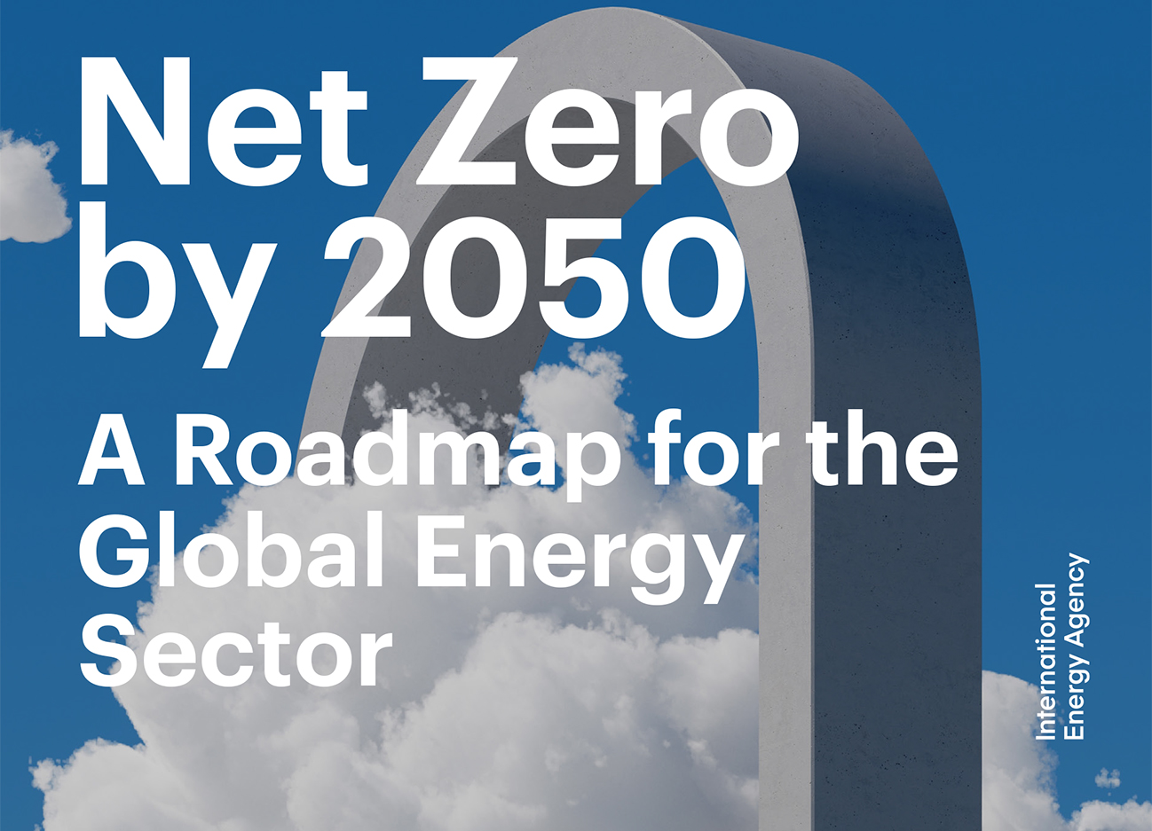
Background
Problem Formulation
Literature Review
Methodology
Outlook
Renewable Energy Integration
Energy Efficiency Enhancement
Low Carbon Emission Transportation
Bouckaert et al. "Net zero by 2050: A roadmap for the global energy sector." (2021).
Chia-Ling Yang | Exploring Reinforcement Learning Solutions for EV-aware Optimal Power Flow Under Uncertainty
Notes:
A roadmap for global energy sector proposed by International Energy Agency

Slide 6
“Security- and Human-centered Energy Transition”
Background
Problem Formulation
Literature Review
Methodology
Outlook
IEA (2023), World Energy Outlook 2023, IEA, Paris https://www.iea.org/reports/world-energy-outlook-2023, Licence: CC BY 4.0 (report); CC BY NC SA 4.0 (Annex A)
Rising Penetration of Intermittent Renewable Energy
High Uncertainty of Power Generation
Extreme Weather
Constantly Increasing Energy Demand
Rising Popularity of EVs
Increasing EV Charging Demand
Chia-Ling Yang | Exploring Reinforcement Learning Solutions for EV-aware Optimal Power Flow Under Uncertainty
Notes:
A roadmap for global energy sector proposed by International Energy Agency

Slide 7
Background
Problem Formulation
Literature Review
Methodology
Outlook
Who cares about the problem? Why is the problem important for them?
Chia-Ling Yang | Exploring Reinforcement Learning Solutions for EV-aware Optimal Power Flow Under Uncertainty

Slide 8
Possible solutions: mathematical optimization v.s. reinforcement learning
Chia-Ling Yang | Exploring Reinforcement Learning Solutions for EV-aware Optimal Power Flow Under Uncertainty

Slide 9






Explain more about RL
$$ℙ(s_{t+1}|s_{t},a_{t})$$
Environment
$$s_{t}$$
$$s_{t+1}$$
$$a_{t}$$
$$r_{t}$$
Agent
$$π(a_{t}|s_{t})$$
Chia-Ling Yang | Exploring Reinforcement Learning Solutions for EV-aware Optimal Power Flow Under Uncertainty

Slide 10








Explain more about RL
$$π(a|s;θ)$$
$$V\left(s;w\right)≅V(s)$$
$$V(s)$$
$$a$$
Actor
Critic
$$a$$
$$r$$
$$s$$
$$s^{′}$$
Environment
Chia-Ling Yang | Exploring Reinforcement Learning Solutions for EV-aware Optimal Power Flow Under Uncertainty

Slide 11
Project Goals
Chia-Ling Yang | Exploring Reinforcement Learning Solutions for EV-aware Optimal Power Flow Under Uncertainty

Slide 12
Problem Formulation

Slide 13
Objective
Chia-Ling Yang | Exploring Reinforcement Learning Solutions for EV-aware Optimal Power Flow Under Uncertainty

Slide 14
Constraints
Chia-Ling Yang | Exploring Reinforcement Learning Solutions for EV-aware Optimal Power Flow Under Uncertainty

Slide 15
Literature Review

Slide 16
Chia-Ling Yang | Exploring Reinforcement Learning Solutions for EV-aware Optimal Power Flow Under Uncertainty

Slide 17
Methodology

Slide 18
Markov Decision Process
Chia-Ling Yang | Exploring Reinforcement Learning Solutions for EV-aware Optimal Power Flow Under Uncertainty

Slide 19
Actor-Critic Framework
Chia-Ling Yang | Exploring Reinforcement Learning Solutions for EV-aware Optimal Power Flow Under Uncertainty

Slide 20
PPO
Chia-Ling Yang | Exploring Reinforcement Learning Solutions for EV-aware Optimal Power Flow Under Uncertainty

Slide 21
Implementation - Training

Slide 22
Critical Components in RL
Environment:
State:
Action:
Reward:
Chia-Ling Yang | Exploring Reinforcement Learning Solutions for EV-aware Optimal Power Flow Under Uncertainty

Slide 23
Uncertainty
Renewable power generation
Power consumption
Charging/discharging demands
Chia-Ling Yang | Exploring Reinforcement Learning Solutions for EV-aware Optimal Power Flow Under Uncertainty

Slide 24
Assumptions
Chia-Ling Yang | Exploring Reinforcement Learning Solutions for EV-aware Optimal Power Flow Under Uncertainty

Slide 25
Neural Network Architechture
Chia-Ling Yang | Exploring Reinforcement Learning Solutions for EV-aware Optimal Power Flow Under Uncertainty

Slide 26
Training Performance
Chia-Ling Yang | Exploring Reinforcement Learning Solutions for EV-aware Optimal Power Flow Under Uncertainty

